Slide 1


Inferring Phylogenies: BEAST2 and the Protracted Birth-Death model
By Femke Thon & Jolien Gay
Supervisors: Richel Bilderbeek & Rampal Etienne

Slide 2


Research Question
If speciation in nature takes time,
what is the error BEAST2 makes in inferring a phylogeny?

Slide 3
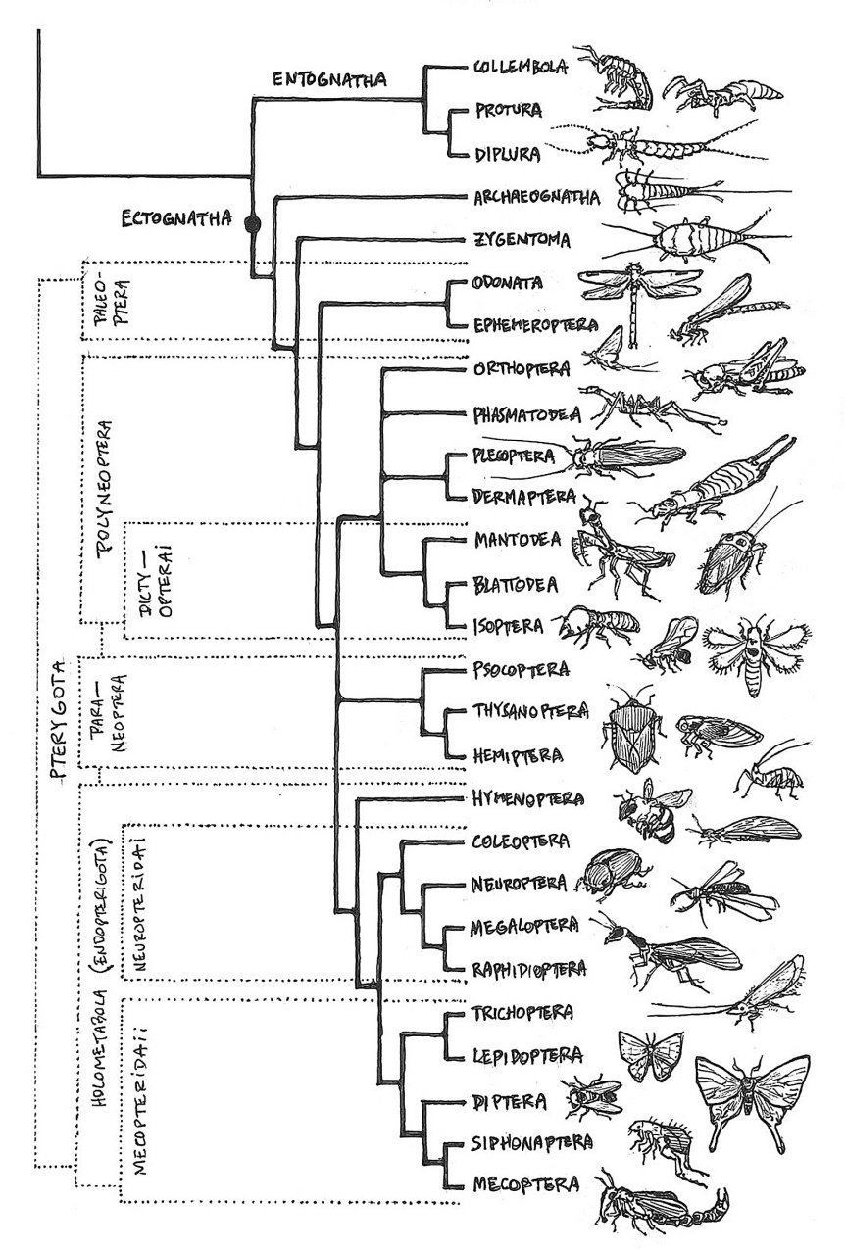
Introduction
Speciation
Evolutionary process
Population -> distinct species (reproductive isolation)
Temporal pattern ??
Phylogenies
Speciation models
Notes:
https://www.reddit.com/r/biology/comments/2t0cgo/a_handdrawn_poster_with_almost_all_insect/

Slide 4
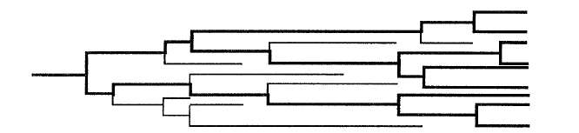
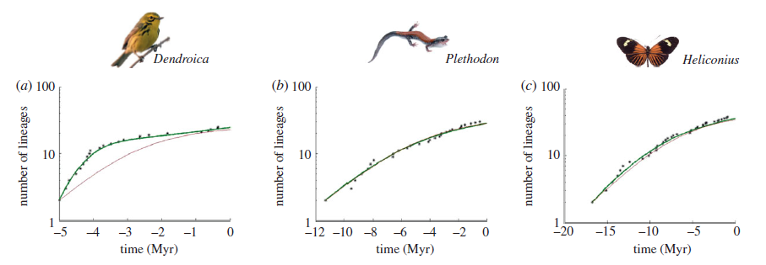
Introduction
Pure Birth-Death model (BD)
Constant speciation and extinction rates
Instant speciation
Number of lineages increase (pull of the present)
BUT: slowdown observed towards the present
Nee Et Al (1994)
Etienne Et Al (2011)

Slide 5
Introduction
Possible explanations:
Sampling artefact
Small sample -> slowdown (Nee et al. 1994b)
BUT: not with complete phylogenies (Phillimore and Price 2008)
Diversity dependence
Slowdown due to niche filling (Ricklefs 2010)
BUT: new species -> new niches (Odling-Smee et al. 2003)
Notes:
Two possible explanations have been proposed to try and explain the observed slowdown
Sampling artifact: 2 artefacts have been found (if a small sample from the actual phylogeny is taken,
BUT: in nearly complete phylogenies, sampling artefact does not explain the observed slowdown
Species-level density dependence: no constants speciation or extinction rates like in the pure BD model. Because of niche filling they will decrease with time.
BUT: new species may create new niches

Slide 6
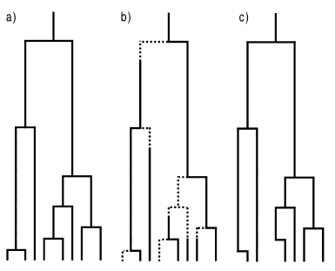
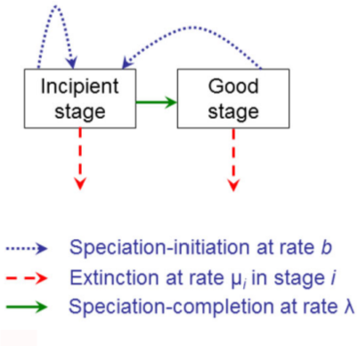
Introduction
Protracted Birth-Death model (PBD)
Extension of BD
Assumes speciation takes time
Assumes two stages
BD | PBD | phylogeny
Etienne and Rosindell (2012), Etienne and Rosindell (2014)

Slide 7
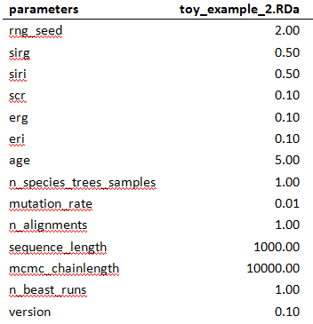
Material & Methods: Start
Important parameters:
Sirg: speciation initiation rate good species
Siri: speciation initiation rate incipient species
Scr: speciation completion rate
Erg: extinction rate good species
Eri: extinction rate incipient species
Age
Mutation rate
Sequence length
Notes:
Example parameter file
- In our research: Around 1000 parameter files
- Age represents total length of tree (we used 5 and 15 MY to illustrate the difference)

Slide 8
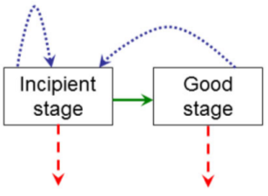
Material & Methods: Start
Important parameters:
Sirg: speciation initiation rate good species
Siri: speciation initiation rate incipient species
Scr: speciation completion rate
Erg: extinction rate good species
Eri: extinction rate incipient species
Age
Mutation rate
Sequence length
Notes:
Example parameter file
- Speciation completion rate

Slide 9
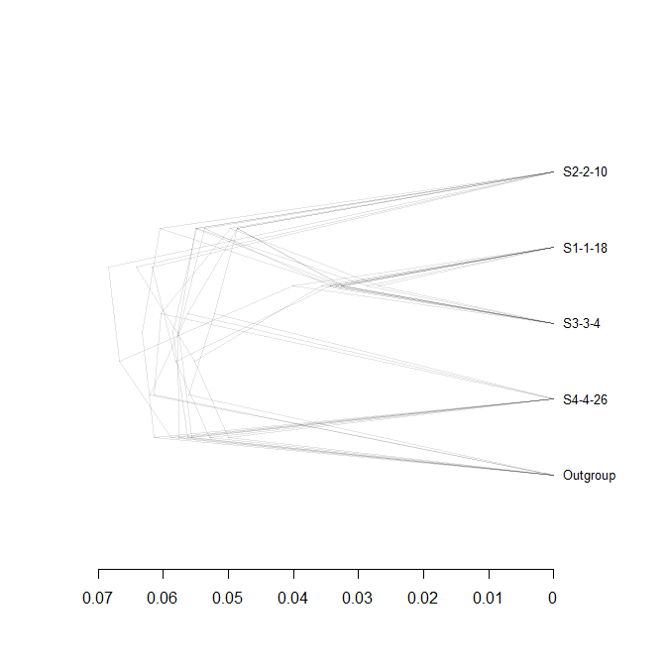
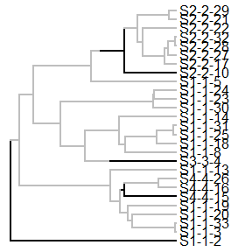

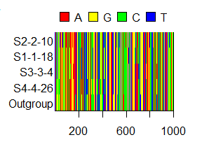
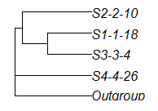
Material & Methods: Workflow
‘true’ tree
posterior
sampled species tree
alignment
Notes:
True tree: 1 per parameter file (around 1000 pmf)
Species tree: 2 per incipient species tree
- Outgroup added to make the phylogenetic inferring software able to root the tree
- BEAST2 assumes a monophyletic species tree (instant speciation -> no multiple individuals / species)
Alignment: 2 per sampled species tree
- 2 BEAST runs per sampled tree
Posterior: 8 posteriors / parameter set (incipient tree)

Slide 10
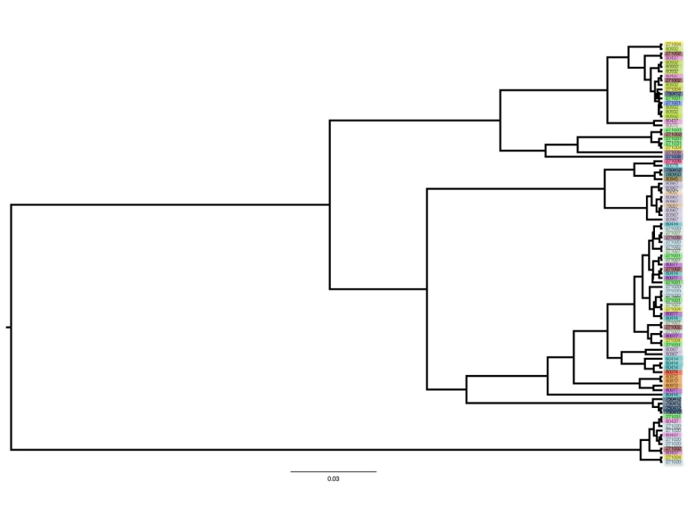
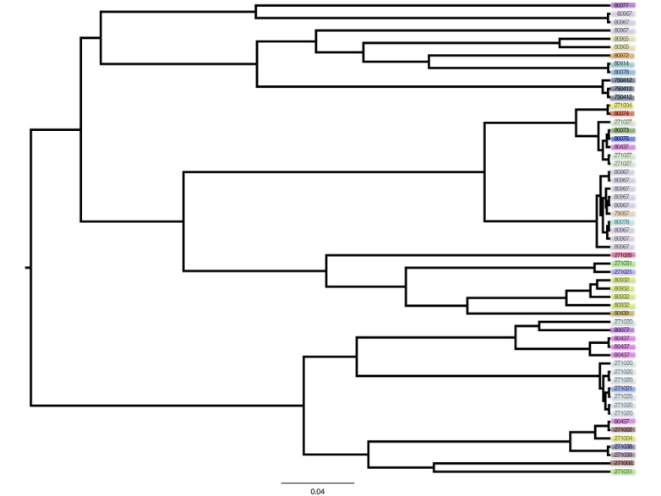
Material & Methods: Analysis
Gamma (γ) statistic:
Distribution of branching events within the tree
Tree ‘stemmy’ or ‘tippy’
Compare sampled species tree gammas with posterior trees gammas
Stemmy (γ > 0)
Tippy tree (γ < 0)
Notes:
?????

Slide 11
Main Question
If speciation in nature takes time,
what is the error BEAST2 makes in inferring a phylogeny?
Sub questions
Can BEAST2 accurately recover a ‘true’ tree?
Error big enough?

Slide 12
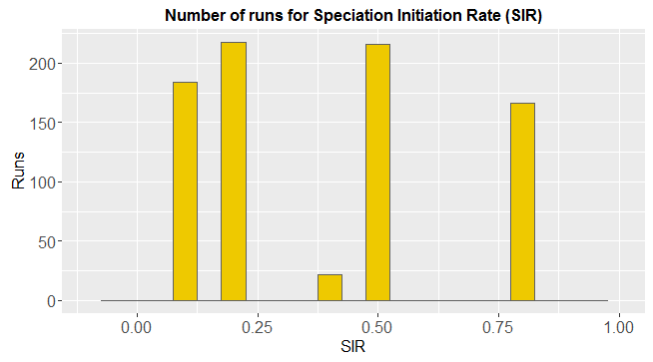
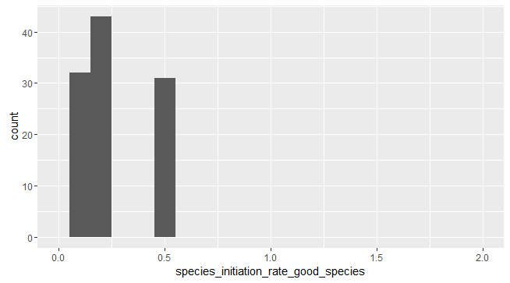
Results: promising differences

Slide 13
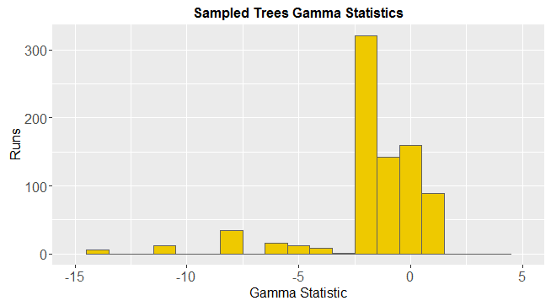
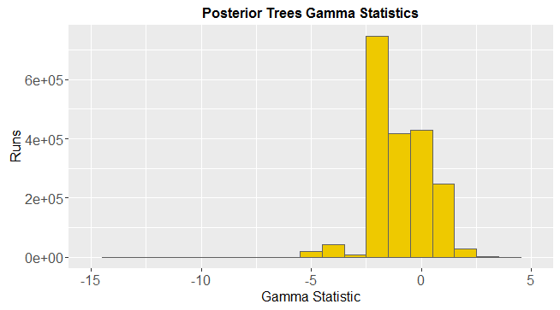
Results: promising differences

Slide 14
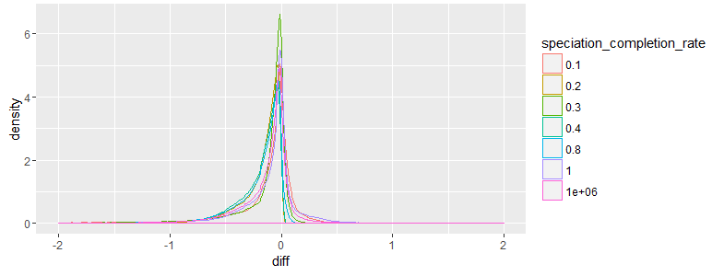
Results: Comparing BD and PBD

Slide 15
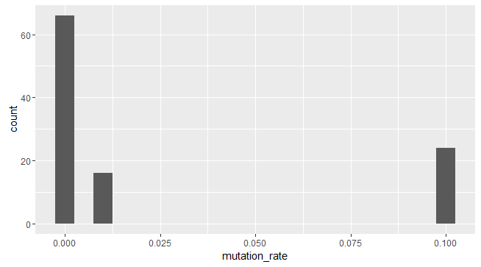
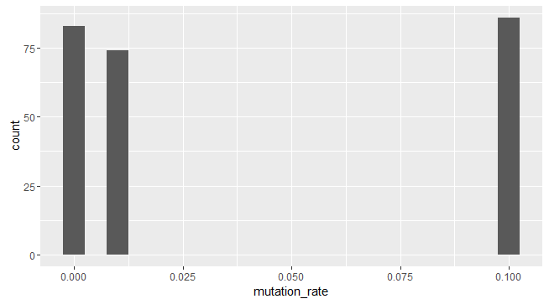
Results: Mutation Rate
Big difference
Small difference

Slide 16
Discussion & Conclusions
Error gamma statistics: not substantial.

Slide 17

Questions
Notes:
POSSIBLE QUESTIONS?:
Q1: Why did you use an outgroup?
Q2: Are the used summary statistics the best, and why?

Slide 18

BEAST2
Bayesian statistics
MCMC
Multiple speciation models can be applied
All assume instant speciation
Posterior
Prior
Likelihood
Marginal probability

